Slide 1

https://www.uni-goettingen.de/en/48115.html
Unless I explicitly state otherwise, images and cartoons are created using ChatGPT.
You may use this material free of charge under the terms of the CC BY license. This requires that you provide appropriate attribution to the author: W. Link, University of Goettingen, Germany.
In a few cases, individual images, photographs, or similar material may be subject to a more restrictive Creative Commons license. Where this applies, it is explicitly indicated, and you must comply with the stated license terms for those items.
Please check the license information carefully before reuse. Responsibility for complying with the applicable license terms rests entirely with you.
UNPLAB-h²_GxE_Ch-1[Broad Sense h²]
We use data from 12 Environments and 36 Genotypes to talk about Heritability h² (broad sense)
1

Slide 2

Sequential Number: #13
UNPLAB-h²_GxE_Ch-1[Broad Sense h²]
You should ;-) have already studied the Population Genetics Chapters, so meanwhile you know ’me’; ... style etc.
I am Wolfgang Link. From 1995 on for several decades I taught Plant Breeding at Georg-August University Göttingen, Germany (ww.uni-goettingen.de/de/48115.html). UNPLAB means ‘Understand Plant Breeding’. If you find mistakes (you will, although I tried hard to avoid them), please tell me so. My first language is German, so if you know German you may understand my English better than if not ☺. I you find this œvre useful, tell others to use it as well. I personally am completely in favour of this material being free for use in whatever way, but everyone must know for themselves how to deal with copyright and the like. I have tried hard to quote everything correctly.
I have no financial intentions or dependencies or anything like that, I was and am completely free in what I write.
I have gladly and with commitment put the sum and essence of my teaching into this form and shape; to make the field of Plant Breeding accessible to learners and experts – yet in my own way. I hope it helps; one or the other.
© W. Link
2

Slide 3
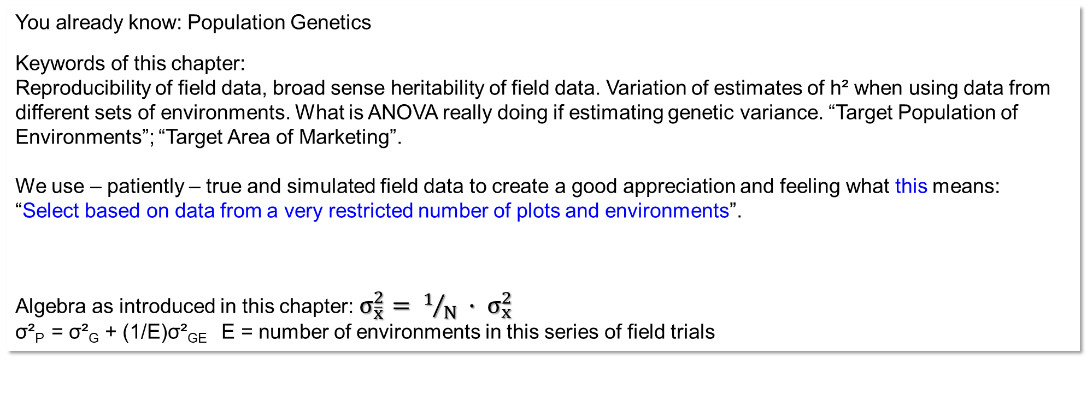
You already know: Population Genetics
Keywords of this chapter:
Reproducibility of field data, broad sense heritability of field data. Variation of estimates of h² when using data from different sets of environments. What is ANOVA really doing if estimating genetic variance. “Target Population of Environments”; “Target Area of Marketing”.
We use – patiently – true and simulated field data to create a good appreciation and feeling what this means:
“Select based on data from a very restricted number of plots and environments”.
Algebra as introduced in this chapter: $σ_{\overline{x}}^{2}= 1/N ∙ σ_{x}^{2}$
σ²_{P} = σ²_{G} + (1/E)σ²_{GE} E = number of environments in this series of field trials
3

Slide 4
We are now using the topic ‘Local Breeding’ vs. ‘Formal Breeding’
DOI 10.1016/j.fcr.2008.07.013
DOI 10.1007/s10681-007-9603-3
... which is the topic ‚Breeding for a very small vs. a large region in which our cultivar should be grown‘
... to discuss GxE; specifically GxL (G x Location) as part of GxE.
And: We are looking at the difference between ‚Reproducibility‘ and ‚Heritability‘ (broad sense*) to again discuss GxE interactions. First without figures and without Algebra.
After a dozen or so pages, we then enter into data examples:
To deduce and show what h² ‚really‘ means.
4
*Narrow sense heritability – of course – exists, we will deal with it later, e.g. as we enter Quantitative Genetics.

Slide 5
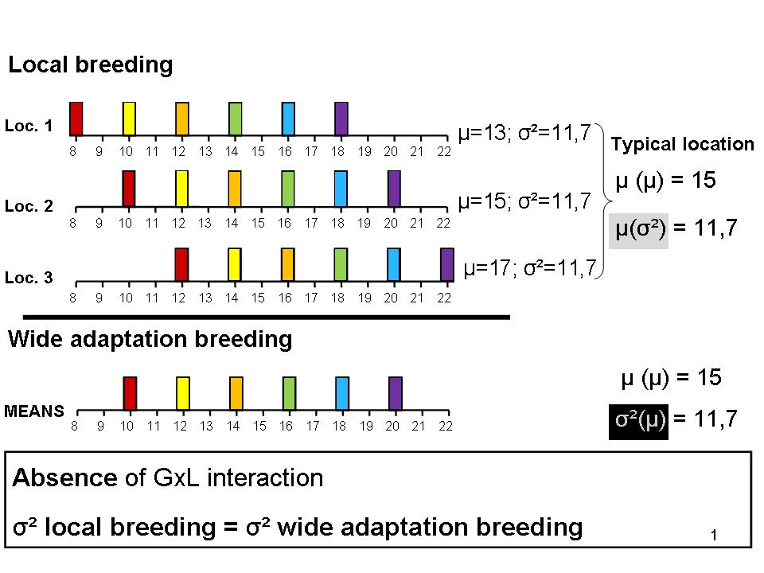
Local Breeding vs. Formal Breeding (which is more or less ‚wide adaptation breeding‘)
A breeding company would select according to the mean value of the candi-dates across their test en-vironments: Because they do not breed for just one farm; instead they breed for a larger Target Area* of Marketing.
In this overly simplistic data example, the mean of the single-location variance is not larger than the variance between the 6 candidates’ means across three locs. (both values are 11.7 here).
Each farmer gets then the candidate that was best in her farm (the violet genotype). Fine :-)
… oftentimes in the frame of Organic breeding
… typically by breeding companies
*Although the term says ‘Area’, it does include the time scale. Breeding is for the future seasons in the Target Area, of course.
5

Slide 6
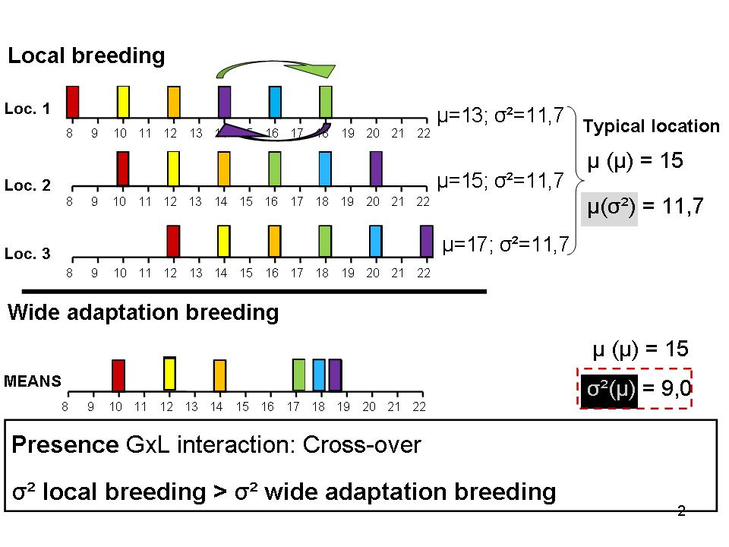
Local Breeding vs. Formal Breeding. Now: GxL interactions are not zero.
Our GxL here stands for the more general GxE
We write GxL but we may mean GxE.
The violet candidate is, in location 1, not the best. All else is the same as before. Especially: The average variance at the three locations is un-changed: µ(σ²)=11.7. But ...
Now, the variance between the mean of the six candi-dates became smaller: 9.0 < 11.7. The (average) vari-ance at one location µ(σ²)=11.7 is larger than the variance between the means (across locations; σ²(µ)=9.0.
The mean variance µ(σ²) is larger than σ ²(µ), the variance between the means.
© Courtesy L. Ghaouti ;-) https://s.gwdg.de/JFGKVi
6

Slide 7
Local Breeding vs. Wide Adaptation Breeding. Now: GxL interactions are not zero.
Our GxL here stands for the more general GxE
The mean variance is larger than the variance between the means.
You could construct data which present the same message even if e.g. one locations‘ variance was smaller than σ²(µ). Assume σ²=8.7 & σ²=11.7 & σ²=14.7 at these three locations. Still, the typically to be expected variance at one location would be σ²=11.7 and would be larger than the variance between the means across locations.
The best way to under-stand something like this is to create data yourself.
© Courtesy L. Ghaouti ;-) https://s.gwdg.de/JFGKVi
7

Slide 8
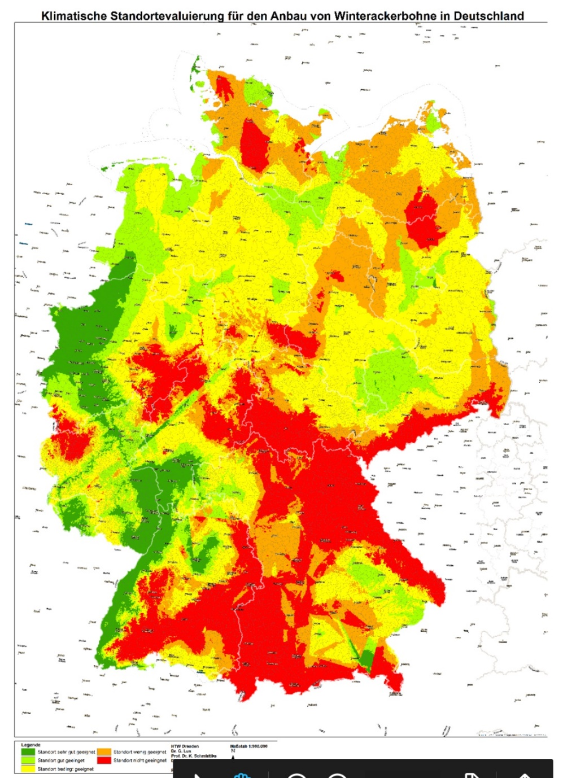
If GxL interactions are not zero, we expect a larger variance between the candidates at one location than if considering their means across the locations (environments).
It is of course not affordable to breed specifically for each farm or each re-gion. And if, then any such single-farm breeding program would be small as compared to the program of a compa-ny that is focussed on a wide area of marketing. A tiny budget for the local breeding would for sure result in little genetic gain. Yet, let us for a moment just ignored such restrictions ...
… if we had local breeding programs and compared these with one centralized program …
In local breeding, if we have a specific breeding program for each location, then even in case of GxL≠0, each farm can get the best available geno-type: In Loc. 1 the green one and in Locs. 2 and 3 the violet.
In case of GxL≠0, a breeding company can not sell the locally-best cultivars to each farm be-cause they only sell one-best cultivar, and that one is only best on average and not locally. The company will recommend the violet cultivar even for Loc. 1 although … you see the point.
8

Slide 9
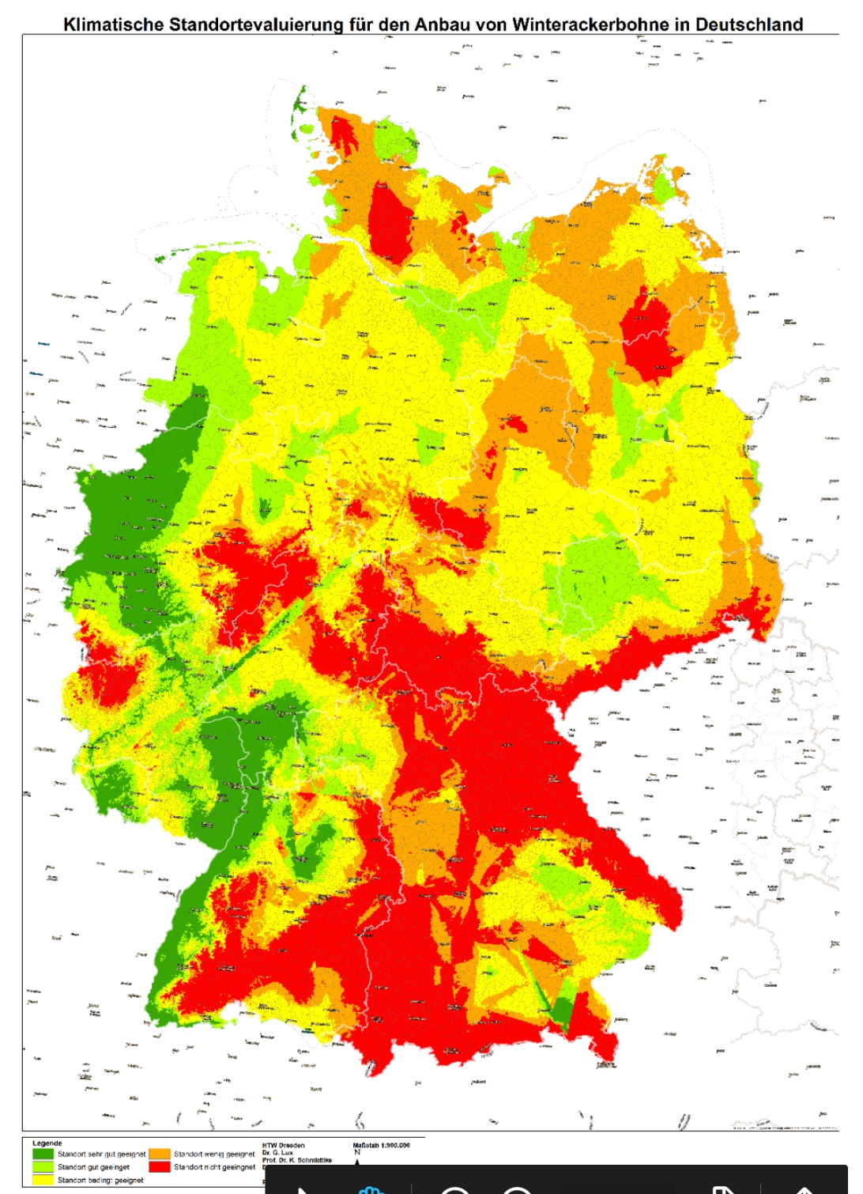
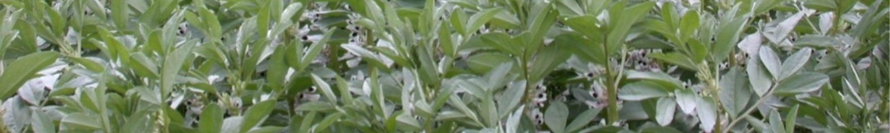
The greener (the less-red), the more the region was found to be favourable to grow winter faba beans (site not too dry; not too winter-cold; not late-freezing in spring time).
One of the many decisions in Pant Breeding is: For whom do we breed? So, what is our Target Area of Marketing (aka Target Population of Environments)? One fraction of the environmental features is (potentially) ‘permanent’ and could potentially be exploited by Local Bree-ding (for genetic adaptation to that area). These are Site (Location), hence specific longitude, latitude, elevation (daylength, mean tempe-rature); and soil type. Moreover, features such as conventional vs. organic, placement of our crop in the rotation will be ‘permanent’, predictable.
We would be much better off, if climate & weather conditions were ... okay, site-specific ... but couldn’t they be predictable per site? Yet, it is not so. Weather is little predictable, even for ‘local’ breeders, farmers.
DOI 10.3389/fpls.2021.638520
http://hdl.handle.net/10883/3150. Atlin, Kleinknecht, Singh, Piepho, 2011. Managing Genotype x Environment Interaction in Plant Breeding. A selection Theory Approach.
Favourable regions to grow winter faba beans
© Lux, Schmidtke, Dresden, 2020
9

Slide 10

What is our Target Area of Marketing (aka Target Population of Environments)?
https://doi.org/10.2135/cropsci1978.0011183X001800050013x Target Population of Environments
12 locations to make a representative sample of locations where winter faba beans may be tested for cultivar selection ...
to represent the Target Area of Marketing of our winter faba bean cultivar.
Selection is then based on average yield across these 12 loca-tions (and several seasons, of course ;-) …. Selection, hence, is based on ~ wide adaptation to this area. Again, not for each specific site the specifically ‘there-best’ genotype will be released as cultivar for such site, nominated for just one farm or small region and grown there. No, that is generally not done.
To be honest, the marketing area specified here is far too small. Especially for a crop such as faba bean, grown on less than 1% of the arable land, the volume of seed sold in such restricted area would not finance a serious breeding program. Anyway, it is (hopefully) not just the cultivar(s) from one breeder that are grown by the farmers. Breeders try to realize marketing areas such as BENELUX plus Poland plus Denmark & Sweden plus parts of Canada ... or the like.
https://s.gwdg.de/xwq1na
10

Slide 11
We are going to look at the difference between
‚Reproducibility‘ and
‚Heritability‘ (broad sense)
to again discuss GxE interactions.
Still, at first without figures and without Algebra.
Yet, soon we will enter into a first and a second data example:
To deduce and visualize what h² ‚really‘ means.
11

Slide 12
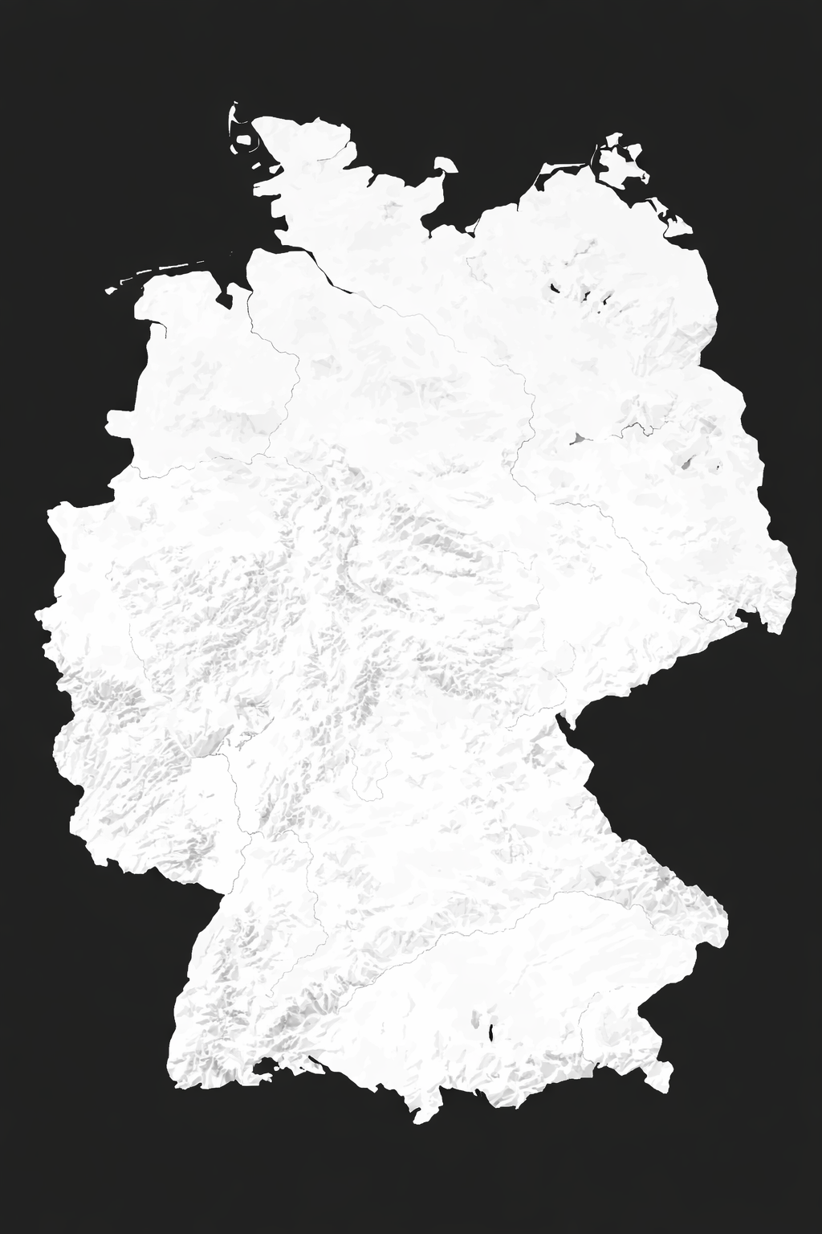
Number of locations L=1
Number of years Y=1
Number of replicates R=4
See on left side indicated four plots with six rows each of the plants of one candidate genotype. There are many candidates (only the four plots of one candidate are drawn). Candidates are tested at (L=1; Y=1) one site (red dot on map) in one season. Would the results be different if we had not 4 but very many replicates per candidate? Surely! R=4 is fine but more is better.
2026
2026
12

Slide 13
Number of locations L=1
Number of years Y=1
Number of replicates R=4
Test of candidates (one candidate’s field plots drawn) in four plots at one site in one year.
What is the Reproducibility of the data generated here in this way? What is meant by Reproducibility?
One of the many plants in this plot (and hence in this replicate of this candidate).
The mean of 4 plots at this environment tells (describes, estimates) performance of this candidate – in this environment.
2026
The result (for yield, for instance) of this candidate would be ‚preciser‘ if we had more replicates and larger plots (more plants per plot). With N plants per plot, the expected single-plant error variance σ²_{ë} attached to any plot-result is σ²_{ë}/N. The expected error variance attached to the mean-of - r=4 plots is then σ²_{ë}/4N.
You see the point.
The basic reasoning applies as well to data from lab test (such as seed protein content) or green-house test (such as resistance screening) and so on.
2026
13

Slide 14
2026

Slide 15
‚Reproducibility‘ of 100% would say that our actual data from such as R=4 replicates and given plot size for our candidates tells us the same as if we had R=∞ replicates.
‚Reproducibility‘ of 50% would say that 50% of the variation of the unknown means from R=∞ (of the truth) could be explained by their linear regression on our actually available data (means from R=4).
Even a Reproducibility of 100% would not say much about the ability of our data to well-correlate with data from different environments (sites, seasons). If we test here-and-now, we mainly learn about the ‘behaviour’ of our candidates here-and-now.
Well: This restriction holds as long as we do have GxE interactions.
15

Slide 16
Our current data (R=4, L=Y=1) should be correlated to the true mean performance of the candidates across the target area of marketing. Yet, the correlation may be low. This correlation is, expectedly, the square root of ... what is called Broad Sense Heritability ( ... see later)
Correlation coefficient r between true data (L=Y=∞) and our data (L=Y=1) = h (square root of h²(Broad Sense); as expectation, not in each case*
Regression coefficient b of the true data (L=Y=∞) onto our data (L=Y=1)
= h² (Broad Sense**); as expectation, not in each case*
*not in each case because our experimental data may not have had a well-representative location and season.
**Broad-sense heritability is the appropriate parameter because the superior genotypes we intend to market are the same ones as were tested. In other words, we evaluate candidate cultivars directly, and the best-performing ones are released. This differs from situations in which potential parents are evaluated and the marketed cultivars are their sexually offspring. In that case, we speak of narrow-sense heritability (h²_{N}). That is mentioned later in Quantitative Genetics Chapters. UNPLAB-QuGen_Ch-14[GenetCov II] page ~25.
16

Slide 17
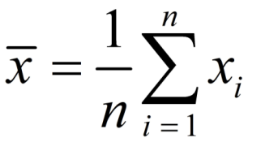
L=Y=1; R=4. Inasmuch can we predict the expected mean performances in our Target Area of Marketing- mean across several seasons (during the ‘live-time’ of the cultivars)? ‘Broad-sense’ because the candidates are genetically unchanged across sites & time.
Derive Broad sense herita-bility h² of such L=Y=1-mean-performance data of cands.
Of course: It is hard to predict the mean performance of our candidates (and their ranking) across an area that includes diverse conditions (soil, weather etc.) and across seasons, and all this just based on but one en-vironments’ results. Maybe our environment was not an outlier, but rather ‘normal’. Then, there may be some information in our data, a non-zero power to predict.
The ‚Broad Sense Heritability‘ of our data (L=Y=1, R=4) may not be zero, it may still be such as h² = 0.2 or 0.4 or the like (depending on case).
h²_{Broad Sense} = σ²_{G} / σ²_{P}
2026
2027
2026
2028
2029
2030
2031
2026
17

Slide 18
The Broad Sense h² of our data would not be h²=1.0 even with data from L>1 and Y>1. The reasoning here is not restricted to the minimum case of L=Y=1.
But, of course, with data from very many locations (such as L=15 or more; and they are nicely representative) across a series of seasons (such as Y=6 or more; and they are nicely representative) ... we expect that we can predict the ranking of candidates’ ‘true’ means more or less precisely.
With high values of L and Y (and R) we expect Broad Sense h² to be very high, nearly h²=1 (100%). This even applies for traits which are in cases such as L=Y=1 showing rather low h²; say 0.2 < h² < 0.5.
This is way ‘official’ tests of VCU (value for cultivation and use*) run
across such as 10<L<15 and 2<Y<3.
*Landeskultureller Wert. www.bundessortenamt.de
18

Slide 19
See several pages of experimental data (https://s.gwdg.de/lb9Gys).
We do not know the Genotypic Values, even these means across E=12 environments are only approximately true, h²=0.71<1. Yet, we take these means as proxi for the G values – here, for teaching.
You will see the difference between selection decisions based on data from one environment and selection decisions based on the means across 12 environments. How much better can you find the truly* superior candidates if you use multi-environmental means vs. means from few or even from only one environment?
In addition: Would selection based on data from a specific environment (e.g. a specific location) be really better if you want to find the best candidate for that specific location (Nota bene: future seasons there).
*in the sense of ‚higher mean performance in the Target Population of Environments‘, i.e., based on G data, i.e., not focussing on GxE caused by a single location which could be your farm.
19

Slide 20
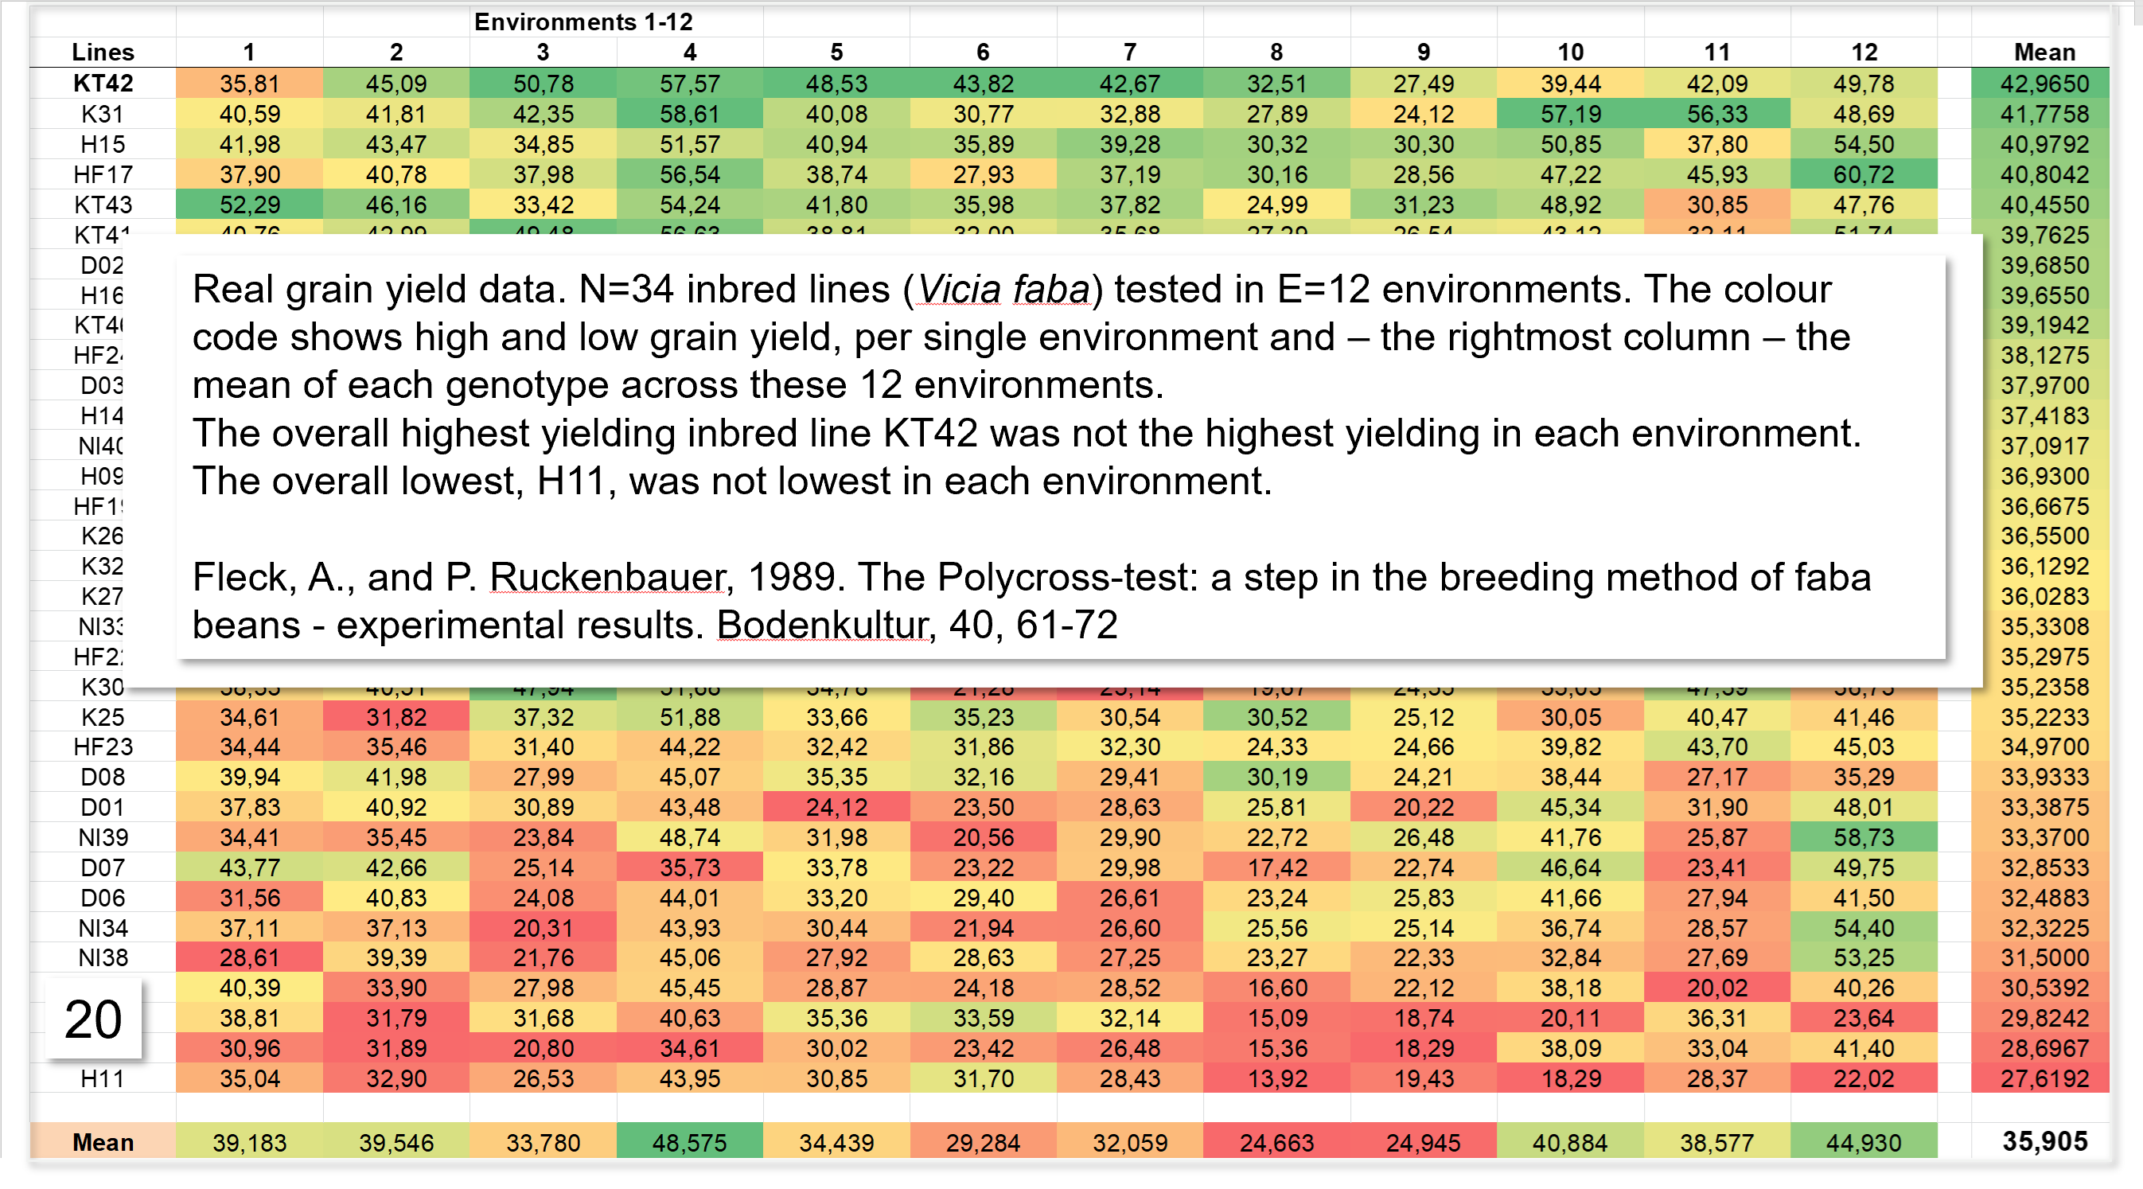
20

Slide 21
Yield (dt/ha) of 34 inbred lines (spring faba bean), tested in 12 environments.
21
Standard deviation of the 34 mean values, SD(µ)=3.824
Variance among these values σ²(µ)=14.623
A breeding company would select based on the mean values of the inbred lines across the environments (‚Formal Breeding‘). This is then based on the column at the far right.
A local breeder would select based on her local (on her single) environment‘s result of the candidates.
Such strategy is more common in Organic Breeding or in Developing Countries (On-farm breeding) than in Conventional Breeding; ... than in highly Developed Countries.
https://doi.org/10.1016/j.fcr.2008.07.013
µ(SD)=6.207;
µ(VAR)=38.522

Slide 22
Yield (dt/ha) of 34 inbred lines (spring faba bean), ranked according to Env. 1.
Environments►
Compare (heat mapping colour) the selection decisions if selection of (for example) best 12 was based on the result in Environment 1 versus the other environments and versus the mean across all 12 environments (last column).
Usually, available data is only from one or few environments and the truth (here approximated by last column) is unknown.
22

Slide 23
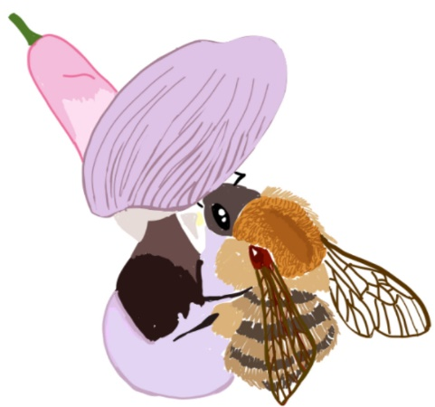
Yield (dt/ha) of 34 inbred lines (spring faba bean), ranked according to Env. 1.
Compare (heat mapping colour) the selection decisions if selection of (for example) best 12 was based on the result in Environment 11 versus the other environments and versus the mean across all 12 environments (last column).
The ‘truly’ highest yielding line 42 (derived from cv. Kleine Thüringer; KT42) ranked only 15.-best as judged from environment 11.
© Mila Tost
23

Slide 24
As examples, you see the correlation coefficient and the co-distribution of the results at the environments 1, 2 and 11 versus the mean across all 12 envs. (here-taken as proxi for the genetic truth).
Note that the single environments differ for the phenotypic σ² of their candidates. The variances between the lines were: σ²_{env.1} = 22.32; σ²_{env.2} = 20.76; σ²_{env.11} = 100.07. Environment 11 led to the largest phenotypic variance. This may help to easier grasp the differences between good and less good candidates at that environment, yet, that large variation should be highly correlated to the ‚truth‘ – which was not the case. That correlation was higher in the other two environments. The mean of these 12 single-environment variances was 38.52 (dt/ha)². The highest correlation to the ‚truth‘ was with environment 7 (r=0.755; the average correlation across E=12 was r=0.634).
55
σ²=22.32
55
σ²=20.76
55
σ²=100.07
50
50
50
r=0.500
Superior 12
Superior 12
r=0.452
Superior 15
45
r=0.671
45
45
40
40
40
Averages across 12 E ('truth')
Averages across 12 E ('truth')
Averages across 12 E ('truth')
35
35
35
30
30
30
25
25
30
35
40
45
50
55
25
25
Results at Environment 1
25
30
35
40
45
50
55
20
25
30
35
40
45
50
55
24
Results at Environment 2
Result at Environment 11

Slide 25
Did we answer this question: ‘Would selection based on data from a specific environment (e.g. a specific location) be really better if you want to find the best candidate for that specific location (Nota bene: future seasons there)’ ?
No. Why not? What would we need to find an answer – which kind of data? Think about it yourself.
We are now leaving this set of experimental data.
Instead, we enter a set of simulated data.
Advantage: We ‚know‘ the G values (since we invented them) ;-)
We nevertheless repeat some of the take-home messages of the last pages - so that they stick in our memory better.
25

Slide 26
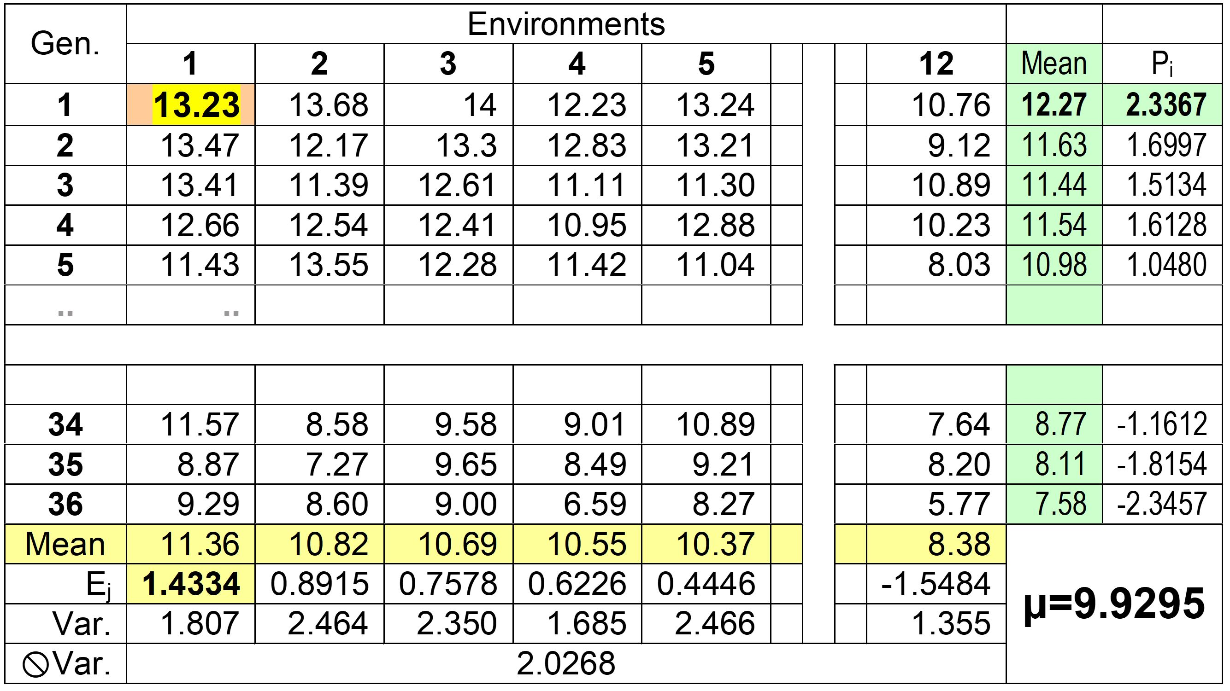

Invented (simulated) data set. There are 12 Environments and 36 Genotypes. Mean is about 10, variances due to Envs. or due to Genotypes or GxE are, each, about 1.00
26
Among Genotypes:
σ²=1.06449
Among Evironments:
σ²_{E}=0.81853
Due to GxE
σ²_{GxE}=1.0498
Grand Mean:
µ=9.92947
….

Slide 27

Invented (simulated) data set. There are 12 Environments and 36 Genotypes. Mean is about 10, variances due to Envs. or due to Genotypes or GxE are, each, about 1.00
Highest result is for Genotype 1 in Environ-ment 1: 13.23. In this environment, the on-average worst genotype yielded 9.29. The variance in that environment was 1.807, the mean performance was 11.36. The mean performance in the weakest environment (E12) was only 8.38, there, the variance between these 36 candidates was 1.355.
Variance between the genotypes was large, 2.826 (Env. 7) and 2.464 (Env. 2) or was small 1.355 (Env. 12) and 1.468 (Env. 9), depending on actual environment.
On average, the mean one-environment variance between genotypes was 2.0268.
2.0268
There were GxE interactions. For instance, the overall worst genotype, Gen. 36, was only the second-lowest performer in environment 1. The range from the largest mean performance of a genotype (G1 with 12.27) to the smallest (G36 gave 7.58) was large, the variance between these 36 Means was 1.06449.
The range from most fertile to least fertile environment was 11.36-8.38 = 2.98.
The variance due to environmental main effects was 0.81853 (not mentioned in this table).
27

Slide 28
The grey eminence behind nearly everything is the Linear Model. De-compose and re-compose a result based on the presumed causal effects from which is ‘modelled’!
Each result here is thought as composed from these effects:
A main effect due to Environment.
A main effect due to Genotype.
An interaction effects GxE.
Y_{ij} = µ + P_{i} + E_{j} + (GE_{ij} + error)
Here, the GxE term includes the error.
We re-compose the value of G.1 at Env.1:
9.9285 + 2.3367 + 1.4334 = 13.6986
13.6986 ≠ observed result of 13.23.
We compare ‘Observed’ vs. ‘Recomposed’
13.23 – 13.6986 = -0.4686
This yields the GxE interaction term of G.1 with Env.1: estimate of G₁E₁ = -0.4686.
There are 12 x 36 such GxE terms.
28
What is e.g. the GxE interaction term of the 35th genotype with the 2nd environment? This GxE is, hence,
7.27 - 9.9295-(-1.8154)-0.8915 = -1.7356. The pooled variance between these 12 times 36 GxE interaction terms is 1.0498, as reported two pages earlier. I am probably not making a sufficiently strict distinction between the true effects and their variances (as exist in the Reference Population) and the effects and variances estimated retrospectively from the sampled data. Well, you can always make it more complicated (and more accurate?).

Slide 29
Invented data set. Here we show the means of the genotypes, across the 12 envs.
1
Take the opportunity to look at how the Values, i.e. the perfor-mance data (left Y-axis) corres-pond to the Effects of the values, i.e. their deviations from their mean value (right Y-axis).
The variance is of course the same, whether calculated from the Values or from the Effects. If you subtract a constant (such as this General Mean), the variance is untouched (the same would be true for a correlation to a second variable).
We measured the genotypes in 12 environments, this is a sound data basis, yet, 12 is less than ∞. Data would be (even) more pre-cise if we had means across >12 environments.
12
2
1
Mean = 9.92947
Variance = 1.06449
10
SD=1.03174
0
Mean performance of 36 genot.
-1
Main effects of genotypes
8
-2
-3
6
2
4
6
8
10
12
14
16
18
20
22
24
26
28
30
32
34
36
Genotypes rank according to mean performance
29

Slide 30
Invented (simulated) data set. There are 12 Environments and 36 Genotypes. Mean is about 10, variances due to Envs. or due to Genotypes or GxE are, each, about 1.00
For the following reasoning we assume:
The 12 environments are a representative sample from our Target Population of Environments (sites, seasons, et cetera), hence, of our Target Area of Marketing (marketing the certified seed of our cultivars).
The 36 genotypes are a representative sample of our breeding germplasm, this is, of our Reference Population.
Mean values and variance that are estimated from their results are useful estimates of the true means and true variances as exist in the Reference Population if growing in the Target Population of Environments.
Yes, in parts this is more philosophy than hard reality. But it's difficult to explain the things of this ‘world’ if you only describe the rough edges and weird states of reality.
W. Link
12
2
12
2
1
1
Variance = 0.81853
10
0
10
SD=0.90473
0
Mean performance of single genots.
Mean performance at (of) single envs.
-1
-1
Main effects of genotypes
Main effects of environments
8
-2
8
-2
-3
-3
6
6
1
2
3
4
5
6
7
8
9
10
11
12
30
2
4
6
8
10
12
14
16
18
20
22
24
26
28
30
32
34
36
12 Environment, ranked according mean
36 Genotypes, ranked after performance

Slide 31
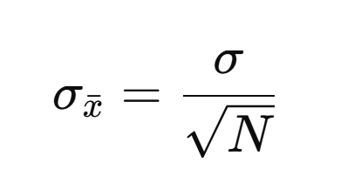
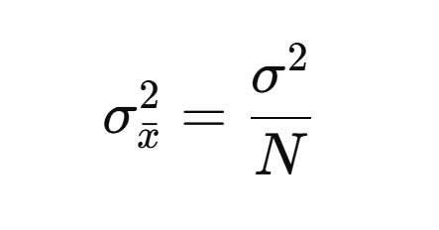
That's clear, isn't it? Just to reiterate.
31

Slide 32
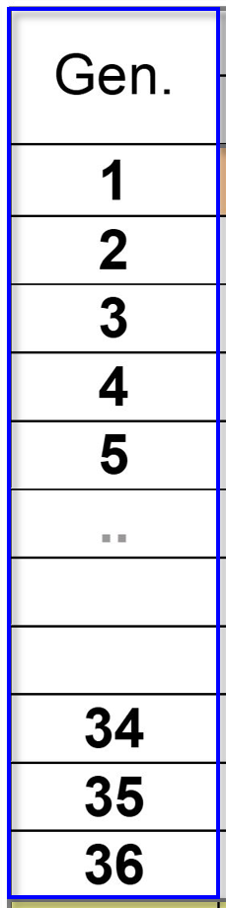
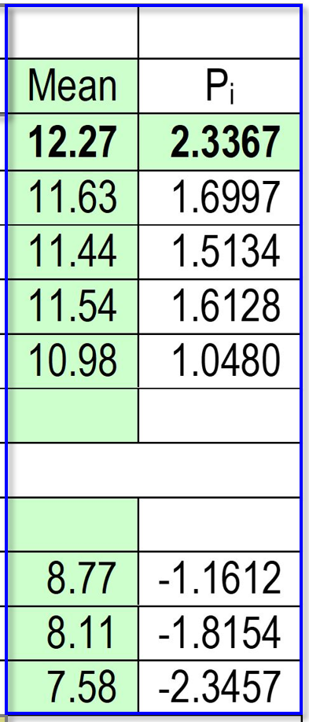
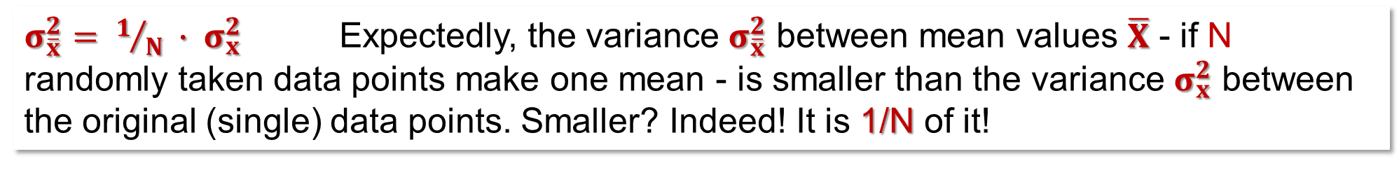
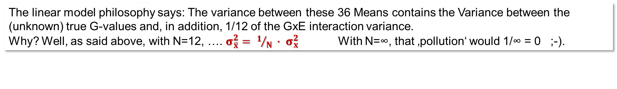
$σ_{\overline{x}}^{2}= 1/N ∙ σ_{x}^{2}$ Expectedly, the variance $σ_{\overline{x}}^{2}$ between mean values $\overline{X}$ - if N randomly taken data points make one mean - is smaller than the variance $σ_{x}^{2}$ between the original (single) data points. Smaller? Indeed! It is 1/N of it!
The large difference between G1 (12.27) and G36 (7.58) is caused by the true, genetic difference between G1 (a superior type) and the inferior G36. It is not impacted by E-effects, because the two means ‘include’ - both - the same and full set of 12 E-effects. G36 can not ‚complain‘ about having been grown in rather ‚bad‘ environments. But. The value 12.27 includes the mean of 12 GxE effects (such as G₁xE₁, G₁xE₂ … until G₁xG₁₂). These are independent from the 12 GxE effects that impact the result of G₃₆; the mean value of G₃₆, (7.58) is impacted (‚polluted‘) by the average of its ‘private’ GxE effects: G₃₆xE₁, G_{36x}E₂ … until G₃₆xE₁₂).
So! Although G₃₆ can't justifiably complain that it was mainly exposed to bad environ-ments, it may be true that the 12 GxE effects which impacted its result happened to be less fortunate than the 12 GxE effects which impacted the result of G₁. Of course, its GxE effects could have been positive on average … ;-)
Did I talk about the ‚true‘ GxE effects in the Target Population of Environments? We: we estimate the GxE-effects (E=12 <∞) with means of zero-’by-force’. Well, just estimates.
The linear model philosophy says: The variance between these 36 Means contains the Variance between the (unknown) true G-values and, in addition, 1/12 of the GxE interaction variance.
Why? Well, as said above, with N=12, …. $σ_{\overline{x}}^{2}= 1/N ∙ σ_{x}^{2}$ With N=∞, that ‚pollution‘ would 1/∞ = 0 ;-).
32

Slide 33
$σ_{\overline{x}}^{2}= 1/N ∙ σ_{x}^{2}$ Expectedly, the variance $σ_{\overline{x}}^{2}$ between mean values $\overline{X}$ - if N randomly taken data points make one mean - is smaller than the variance $σ_{x}^{2}$ between the original (single) data points. Smaller? Indeed! It is 1/N of it!
The large difference between G1 (12.27) and G36 (7.58) is caused by the true, genetic difference between G1 (a superior type) and the inferior G36. It is not impacted by E-effects, because the two means ‘include’ - both - the same and full set of 12 E-effects. G36 can not ‚complain‘ about having been grown in rather ‚bad‘ environments. But. The value 12.27 includes the mean of 12 GxE effects (such as G₁xE₁, G₁xE₂ … until G₁xG₁₂). These are independent from the 12 GxE effects that impact the result of G₃₆; the mean value of G₃₆, (7.58) is impacted (‚polluted‘) by the average of its ‘private’ GxE effects: G₃₆xE₁, G_{36x}E₂ … until G₃₆xE₁₂).
So! Although G₃₆ can't justifiably complain that it was mainly exposed to bad environ-ments, it may be true that the 12 GxE effects which impacted its result happened to be less fortunate than the 12 GxE effects which impacted the result of G₁. Of course, its GxE effects could have been positive on average … ;-)
Did I talk about the ‚true‘ GxE effects in the Target Population of Environments? We: we estimate the GxE-effects (E=12 <∞) with means of zero-’by-force’. Well, just estimates.
33
We are here at an overly enlightening point. Although we can more or less quantify the GxE variance that still ‚pol-lutes‘ our results‘ variance: Even after calculating means across some environments, we can not tell whether any of the genotypes‘ mean values was actually lifted up or pushed down by its GxE interaction effects. High phenotypic values probably were lifted up; but high or low genotypic values are polluted up- or down with same probability!
The linear model philosophy says: The variance between these 36 Means contains the Variance between the (unknown) true G-values and, in addition, 1/12 of the GxE interaction variance.
Why? Well, as said above, with N=12, …. $σ_{\overline{x}}^{2}= 1/N ∙ σ_{x}^{2}$ With N=∞, that ‚pollution‘ would 1/∞ = 0 ;-).

Slide 34
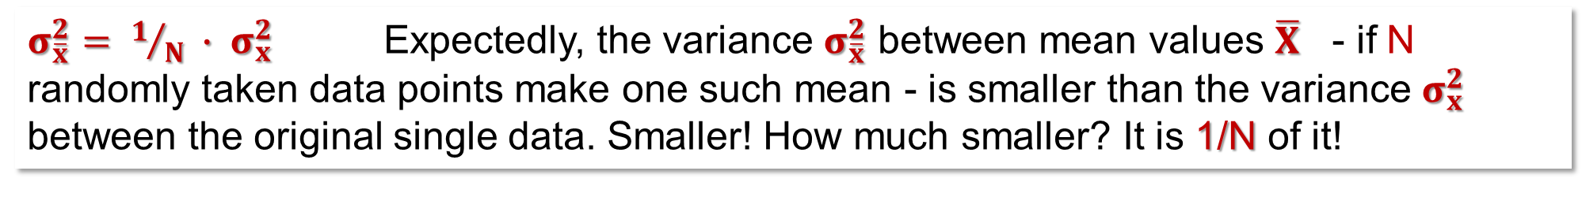
$σ_{\overline{x}}^{2}= 1/N ∙ σ_{x}^{2}$ Expectedly, the variance $σ_{\overline{x}}^{2}$ between mean values $\overline{X}$ - if N randomly taken data points make one such mean - is smaller than the variance $σ_{x}^{2}$ between the original single data. Smaller! How much smaller? It is 1/N of it!
P_{i} = µ + G_{i} + E_{j} + mean-of-12 GE-values
σ²_{Pi} = σ²_{G} + 0 + (1/12)σ²_{GE} = 1.06449
The general mean µ does not impact the phenotypic variance between the genotypes since it is a constant. The E-effects do not impact it, since they are a constant for all genotypes. The GxE-interaction effects impact little, since only the mean of 12 GxE effects goes into one phenotypic result (mean across E=12) of one genotype.
We saw earlier the G₁xE₁ interaction effect as -0.4686.
We saw earlier the G₃₅xE₂ interaction effect as -1.7356.
The pooled variance among all the 432 GxE effects is, see above, σ²_{GE} = 1.0498.
The variance among the 36 P_{i} values is σ²_{Pi} = 1.06449. Knit these insights together!
Subtract 1/12 of 1.0498 from the phenot. variance (σ²_{Pi} = 1.06449) of the genotypes.
The result then should be that very phenotypic variance that would be expected if testing these genotypes across N=∞ environments. Indeed, a very bold extrapolation. Hopefully your environments and genotypes are well representative for the target area of marketing, especially for the future season (weather, climate).
Yet, that’s done! This is the way to estimate the ‚true‘ genetic variance from our error-polluted experimental data.
34

Slide 35
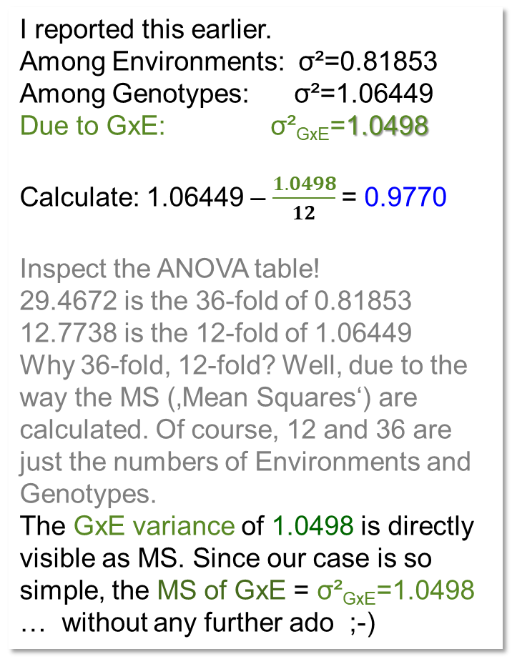
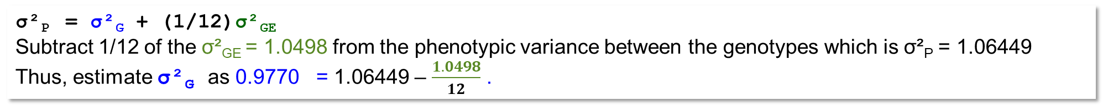
See the ‘magical’ ANOVA-table: ANalysis of VAriance.
You can make your live without. But will you want to?
I reported this earlier.
Among Environments: σ²=0.81853
Among Genotypes: σ²=1.06449
Due to GxE: σ²_{GxE}=1.0498
Calculate: 1.06449 – $\frac{1.0498}{12}$= 0.9770
Inspect the ANOVA table!
29.4672 is the 36-fold of 0.81853
12.7738 is the 12-fold of 1.06449
Why 36-fold, 12-fold? Well, due to the way the MS (‚Mean Squares‘) are calculated. Of course, 12 and 36 are just the numbers of Environments and Genotypes.
The GxE variance of 1.0498 is directly visible as MS. Since our case is so simple, the MS of GxE = σ²_{GxE}=1.0498
… without any further ado ;-)
σ²_{P} = σ²_{G} + (1/12)σ²_{GE}
Subtract 1/12 of the σ²_{GE} = 1.0498 from the phenotypic variance between the genotypes which is σ²_{P} = 1.06449
Thus, estimate σ²_{G} as 0.9770 = 1.06449 – $\frac{1.0498}{12}$ .
35

Slide 36
h²(Broad Sense) to predict performance and to rank in the Tar-get Pool of Environments TPE is the larger, the larger (better) the sample of employed Environments (taken from the TPE) is. Sets of - e.g. - two environments may well lead to different re-sults. Below: ●E8 and E10 or ●E2 and E7 (the two extreme pairs).
r² and b are from these data.
h² estimates are from ANOVA
(not using y-axis data)
13
12
r² =0.752
In ideal setting and situation, r² and b and h² give the same result. Mind: h² is found without knowing the true genotypic data (without y-axis data)
b=0.860
11
h²=0.224
True genotypic values
10
h² = σ²_{G} / σ²_{P}
r² =0.788
9
b=0.579
h²=0.826
8
E8&E10
7
E2& E7
7
8
9
10
11
12
13
Means of genotypes at 2 envs.
36

Slide 37
Why this fuss and ado about heritability h²? Reminder: Here it is Broad sense h²!
37
We behave as if we knew the true G data and the true regression of G on P. If h²=1, then all superiority in P would translate in superiority in G. Yet, h²=b=0.860 ‘here’.
Yet! h²<1 (here, h²=0.860).
The phenotypically highest ranked entries tend to be below the dashed line ( ), the phenotypically lowest entries tend to be above. Why? Breeding and selecting based on phenotypic data, we select based on data on X-axis. Choosing high values on X-axis, you get mostly ones which were pushed high by positive GxE and positive error effects (‘Winners are rather doped than sick’). As consequence, b<1.0.
Using G on the Y-axis and P-data on the X-axis, we get b = R²
(R² = r², if necessary look it up yourself). We get r²=R²=0.752 ≠ b=0.860. Expectedly, R²=b. The gap is not large. Yet, it is not perfect when just analyzing E8 and E10 data.
Last page, ANOVA (only based on Phenotypic data from E8 & E10 and not using y axis data) gave an estimate of h²=0.224, which was the lowest h² from the 66 possible pairs of two environments (E=12). We expect R² = b = h², and in our case, ANOVA-derived h² differed much from what we find when including true G information.
We will disregard this unfortunate result for now.
We use b to tell us h².
Deviations from phenotypic means
-2.5
-0.5
0.5
2.5
13
Mean
2.5
12
R²=0.752
b =0.860
ΔG=0.860∙1.62
=1.39
11
Mean
Genotypic values
10
9
8
-2.5
ΔP=1.62
7
E8&E10
7
8
9
10
11
12
13
Phenotypic values (Ø from 2 envs).

Slide 38
Why this fuss and ado about heritability h²? Reminder: Here it is Broad sense h²!
38
We behave as if we knew the true G data and the true regression of G on P. If h²=1, then all superiority in P would translate in superiority in G. Yet, h²=b=0.860 ‘here’.
We employ h² =0.860 by saying:
Okay, the phenotypic superiority of a superior candidate includes some truth and some noise – and we accept 86% of the superiority as presumably true (b=h²=0.860).
Of course: We are concerned that the Genotypic values are not (all) lying on the regression line (they would if h²=1 …. this would make the regression line identical with the dashed line). These deviations cause us headaches and worries. But so far we can not solve this. Usually we just do not know the truth.
We may, from earlier sets of data, have good hints on h² (sets of similar genotypes, same test sites, same traits). We may have rea-sonable current P data. We shrink the phenotypically claimed supe-riority of a given candidate of 1.62 down to the more credible value of ΔG=0.860∙1.62=1.39 (like this for all candidates). Although we ade-quately shrink phenotypic effects ... we have no tool to know the individual deviations of the G values from the regression line ... - unless we know the G data. Do you feel the pain, too?
By the way. The mean on X-axis was 9.5, smaller than the true mean (mean of G values). That shifted the ‘Diagonal’ up by 0.5 units. Tja.
Deviations from phenotypic means
-2.5
-0.5
0.5
2.5
13
Mean
2.5
12
R²=0.752
b =0.860
ΔG=0.860∙1.62
=1.39
11
Mean
Genotypic values
10
9
8
-2.5
ΔP=1.62
7
E8&E10
7
8
9
10
11
12
13
Phenotypic values (Ø from 2 envs).

Slide 39
Why this fuss and ado about heritability h²? And it is even ‚only‘ broad sense heritability!
We behave as if we knew the true G data and the true regression of G on P. If h²=1, then all superiority in P would translate in superiority in G. Yet, h²=b=0.860 here.
Again: We only have phenotypic data P (X-axis). Yet, from prior knowledge and experience, we may approximately know h² (for given trait and setting). With this, we judge how much of the phenotypic superiority of a candidate (e.g. Δ=1.62) may hold true (Δ =1.39).
39
Deviations from phenotypic means
Deviations from phenotypic means
This is a major infor-mation. We anticipate: From this candidate‘s phenotypic superiority of ΔP = 1.62 only ΔG = 1.39 will prove ‚true‘. True, if later judged from its mean perfor-mance in the Target Population of Environ-ments.
We sampled E=2 from the Target Population of Enviroments and hope they gave us representative P data.
-2.5
-0.5
0.5
2.5
-2.5
-0.5
0.5
2.5
13
13
Mean
2.5
Mean
12
12
b=0.860
ΔG=0.860∙1.62
=1.39
11
11
ΔG =1.39
True genotypic values
True genotypic values are unknown
10
10
Like this for each candidate
b=0.860
9
9
8
8
-2.5
ΔP=1.62
ΔP=1.62
7
E8&E10
7
E8&E10
7
8
9
10
11
12
13
7
8
9
10
11
12
13
Means of genotypes at 2 envs.
Means of genotypes at 2 envs.: E8 and E10.

Slide 40
Rehearsal
See again the two cases in the diagram left side. From ANOVA of data of Envs. 8 & 10, we estimate h²=0.224, whereas ANOVA from Envs. 2 & 7, h²=0.826. These were the two extremes from the 66 possible pairs of two environments ... 66=(12²-12)/2 (two out of the possible 66 h² values). Of course many more h² could be found using data sets from 3 environments, or from 4 .... ;-)
These h² estimates were solely based on the phenotypic data of the employed two environments, without knowing the true G values. Yet: Since we here (simulated data!) ‚know‘ the true G values, we can inspect the regression of these true G values onto their phenotypic counterparts P_{i} (E=2, both cases). That regression b indicates the ‚true‘ h² of the one and the other data set. In one case b=0.860 ≠ h²=0.224; in the other case, b=0.579 ≠ h²=0.826 (r² should, expectedly, be identical to b, which is again not realized). Of course, the ANOVAs of all 66 pairs of environments gave as mean h²=0.6505, which is identical to the ‚true‘ b=r² = 0.6505.
13
12
r² =0.752
b=0.860
11
h²=0.224
True genotypic values
10
r² =0.788
9
b=0.579
h²=0.826
8
E8&E10
7
E2& E7
Of course, the ANOVAs of all 66 pairs of environments gave as mean h²=0.6505, which is identical to the ‚true‘ b=r² = 0.6505.
7
8
9
10
11
12
13
Means of genotypes at 2 envs.
Take home: Although we expect that ANOVA tells us h², this is always an estimate, and with for instance only two environments, estimates can vary and deviate markedly from ‘truth’.
40

Slide 41

Phen. variance of the 36 genotypes at the 12 environments was small (σ²_{P} =1.355, E12) or high (σ²_{P} =2.826, E7).
The phenotypic variance of the 36 genotypes, if means across two envs. were used, was smaller, and varied from 0.968 to 2.252 across all the 66 combinations of 2 environments. The mean was 1.5019
3
Extrapolation from E=2-ANOVAs to E=12 and beyond. With only one set of E=12 at hand, you can not calculate variation between several (or ‘all’) E=12 sets. I did it again as ... extrapolation ;-)
From this visualization you may see that and how ANOVA is ‚just‘ accepting the size and pattern of variation between to P and due to GxE interactions as deduced from the actual data set and then extra-polates ‚as if there were no more tomorrow‘; unre-served, unconcerned, hurray-forward!
There is simply no other possibility as long as you don't know the true G values; you just should be aware of what happens; with a small number of en-vironments, you need to be correspondingly cautious in employing the results.
With a fair number of envs., hence with high h², your phenotypic data well predicts the true h² and the G data and values.
2
Mean = 2.0268
Phenotypic variance between Gentoypes
Mean = 1.5019
Mean =
1.0645
1
Lower Limit = 0.977
41
0
0
1
2
3
4
5
6
7
8
9
10
11
12
13
14
15
16
Number of Environments

Slide 42
From here you may go to UNPLAB-h²_GxE_Ch-2[Stabil]
42

